Slide 1

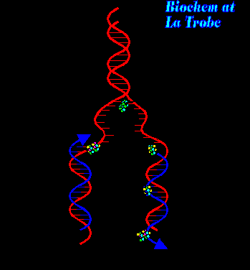
Cell Biology Lec (11)
DNA Replication & Proteins synthesis

Slide 2
DNA replications
1- Before a cell divides, it duplicates its DNA in a copying process called replication.
2- Sites where separation and replication occur are called replication forks.
The DNA replication process:
1- Initiation: The first stage of DNA replication is the uncoiling of the DNA double helix by the enzyme helicase. Helicase separates the DNA into two template strands.

Slide 3
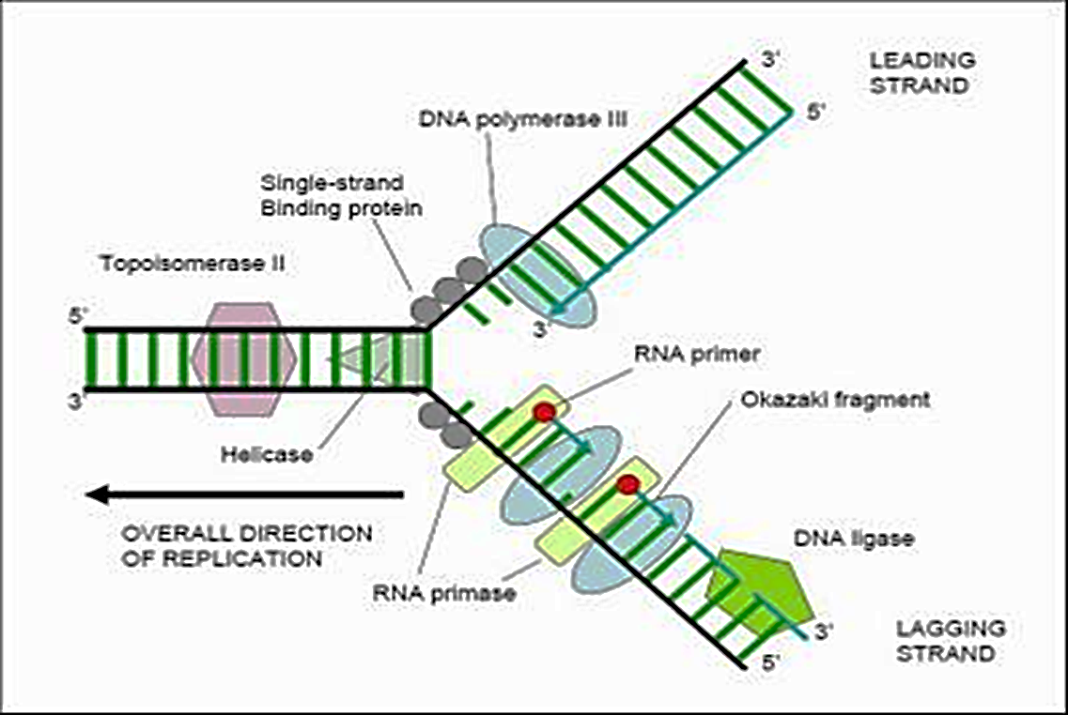
RNA primase then adds a short sequence of RNA to the template strands. This short sequence of RNA is a primer which allows DNA polymerase III to bind to the strands and start the replication process.

Slide 4
The DNA replication process
2- Elongation: DNA polymerase III adds nucleotides to each template strand in a 5'→3' direction. The nucleotides have 3 phosphate groups two of these phosphate groups break off during the replication process to release energy.
Since the two strands have their 5' end and 3' end in opposite sides and replication can only occur in a 5'→3' direction. This means that one of the strands is synthesized in a continuous manner (named the leading strand) while the other one is synthesized in fragments (named the lagging strand). The leading strand only needs one primer while the lagging strand needs quite a few as it is formed in fragments. These fragments are called Okazaki fragments.

Slide 5

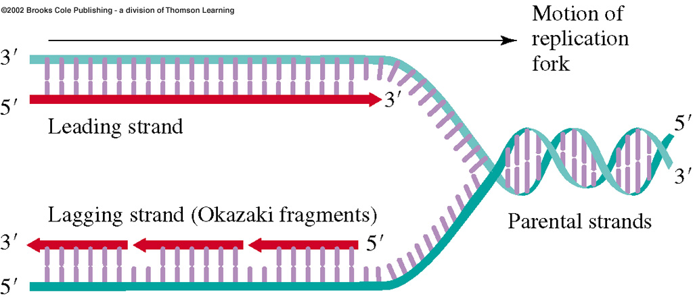

Slide 6
The DNA replication process
3-Termination: DNA polymerase I will remove the RNA primers and replace these with DNA. The enzyme DNA ligase then joins the Okazaki fragments together to form a continuous strand.
Once the new strands are complete, the daughter DNA molecules rewind automatically back to their original helix structure. Each replication results in slightly shorter daughter chromosomes. Eukaryotes have special buffer zones called telomeres at the end of each chromosome to guard against this problem. These are highly repetitive nucleotide sequences typically rich in G nucleotides.

Slide 7

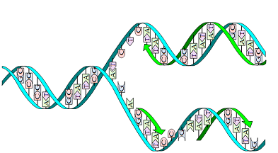

Slide 8
Differences between DNA replication in Prokaryotes and Eukaryotes
Prokaryotes | Eukaryotes
It occurs inside the cytoplasm. | It occurs inside the nucleus.
DNA replication begins at a single point in the chromosome | replication occurs at hundreds of places
Okazaki fragment are large, 1000-2000 nucleotides long. | Okazaki fragment are short, 100-200 nucleotides long.
Replication is very rapid, some 2000 bp per second are added. | Replication is slow, some 100 nucleotides per second are added.

Slide 9
Summary
Helicase uncoils the DNA
RNA primase adds short sequences of RNA to both strands (the primer)
The primer allows DNA polymerase III to bind and start replication
DNA polymerase III adds nucleotides to each template strand in a 5'→3' direction
These nucleotides are initially deoxyribonucleoside triphosphates but they lose two phosphate groups during the replication process to release energy
One strand is replicated in a continuous manner in the same direction as the replication fork (leading strand)
The other strand is replicated in fragments (Okazaki fragments) in the opposite direction (lagging strand)
DNA polymerase I removes the RNA primers and replaces them with DNA
DNA ligase then joins the Okazaki fragments together to form a continuous strand

Slide 10
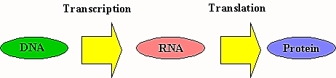
From DNA to Protein
Getting from the code in DNA to the final protein is a very complicated process.
The code is first transcribed "copied" to messenger RNA. That then travels out of the nucleus of the cell (where the DNA is found) into the cytoplasm of the cell. Here the code is read and the protein is synthesised with the help of two other forms of RNA - ribosomal RNA and transfer RNA.

Slide 11
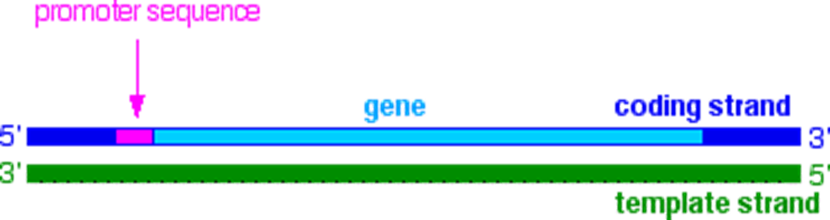
Transcription
Transcription is the name given to the process where the information in a gene in a DNA strand is transferred to an RNA molecule.
The transcription process:
1-Finding the start of the gene on the coding strand.
Transcription is under the control of the enzyme RNA polymerase. The first thing that the enzyme has to do is to find the start of the gene on the coding strand of the DNA. These base sequences are known as promoter sequences.

Slide 12
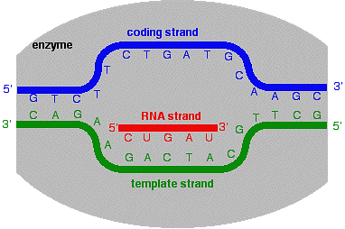
Transcription
2-Once the enzyme has attached to the DNA, it unwinds the double helix over a short length, and splits the two strands apart. This gives a "bubble" in which the coding strand and template strand are separated over the length of about 10 bases.

Slide 13

Transcription
3-Now the enzyme moves along the DNA, closing it up again behind it. Essentially it moves the bubble along the chain, adding new nucleotides all the time. The growing RNA tail becomes detached from the template strand as the enzyme moves along.

Slide 14
Transcription
4-At the end of the gene there will be a termination sequence of bases. Once the enzyme gets to those, it stops adding new nucleotides to the chain and detaches the RNA molecule completely from the template chain.

Slide 15
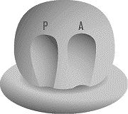
The translation process
In translation, mRNA is sent to the cytoplasm, where it bonds with ribosomes, the sites of protein synthesis. Ribosomes have three important binding sites: one for mRNA and two for tRNA. The two tRNA sites are labeled the A site and P site.

Slide 16
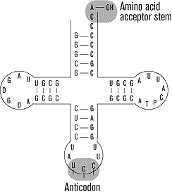
The translation process
tRNA is made up of many nucleotides, at its tail end, tRNA has an acceptor stem that attaches to a specific amino acid. At its head, tRNA has three nucleotides that make up an anticodon.

Slide 17
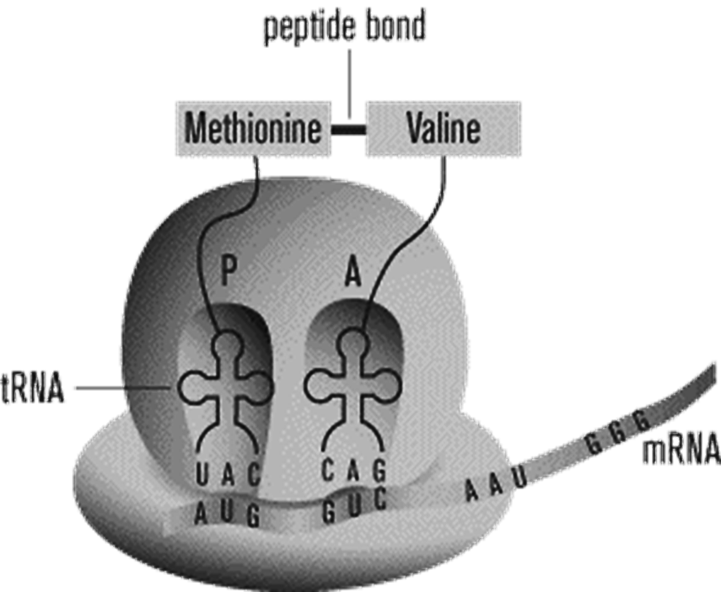
The translation process
Translation begins with the binding of the mRNA chain to the ribosome. The first codon, which is always the start codon methionine, fills the P site and the second codon fills the A site. The tRNA molecule whose anticodon is complementary to the mRNA forms a temporary base pair with the mRNA in the A site. A peptide bond is formed between the amino acid attached to the tRNA in the A site and the methionine in the P site.

Slide 18
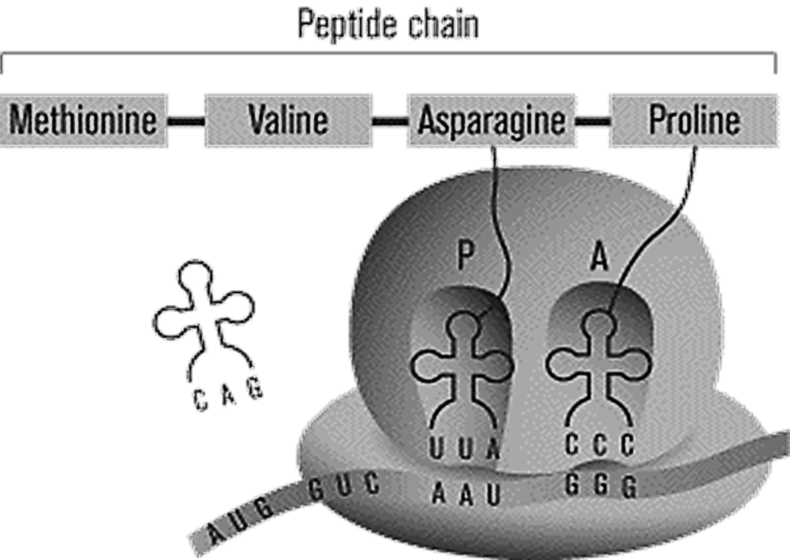
The translation process
The ribosome now slides down the mRNA, so that the tRNA in the A site moves over to the P site, and a new codon fills the A site. The ribosome slides again the tRNA that was in the P site is let go into the cytoplasm, where it will eventually bind with another amino acid. Another tRNA comes to bind with the new codon in the A site, and a peptide bond is formed between the new amino acid to the growing peptide chain.

Slide 19
The translation process
The process continues until one of the three stop codons enters the A site. At that point, the protein chain connected to the tRNA in the P site is released and translation is complete.

